Slide 1


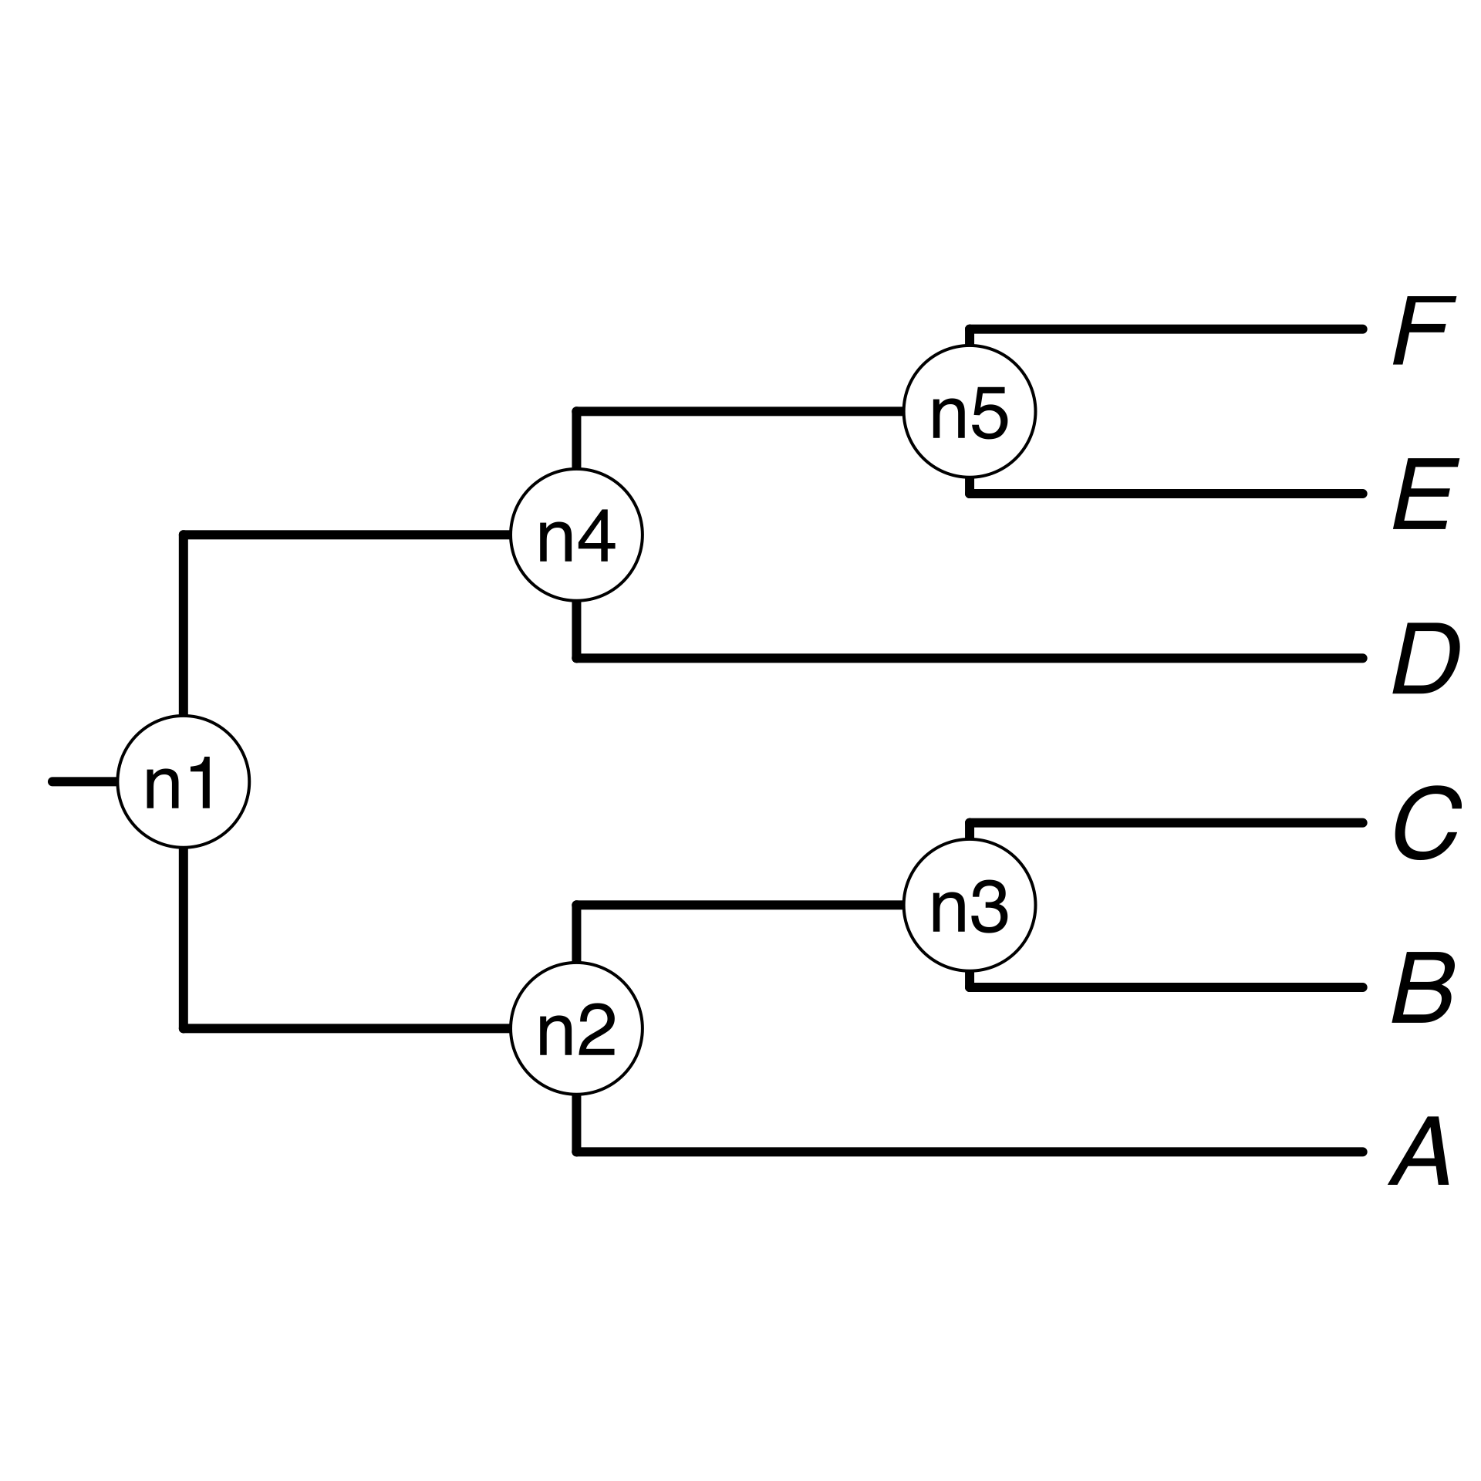
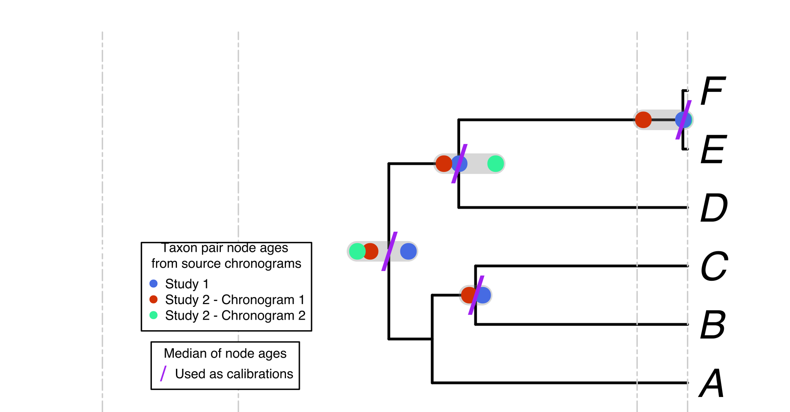
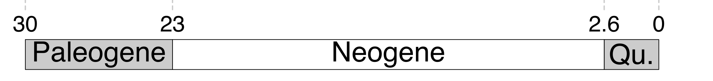
a) Creating a DateLife search query
b) Searching DateLife’s chronogram database
c) Summarizing DateLife’s search results
a1) A list of taxon names is
provided by the user. It can
contain synonyms and
misspellings:
c1) A tree topology of the taxa of interest is chosen:
The largest source chronogram
b1) Processed taxon names are searched in
DateLife’s chronogram database and identified (*):
c2) Nodes from source chronogram are congruified to nodes in the tree topology:
a
B₁
C
D
Ee
F_{x}
Your own
tree
A tree from the
literature
A tree topology
*
*
a2) Taxon names are processed
using the Taxonomic Name
Resolution Service (TNRS)
and are standardized to a
taxonomy:
*
b2) Matching chronograms are pruned and saved as
source chronograms:
c3) Congruified node ages are summarized
by node:
Median summary chronogram
A
B
C
D
E
F
c4) Summary ages of congruent nodes are used as secondary calibrations to date the tree topology.
In this example, 4 names are synonyms in the standardized taxonomy, shown in bold.

